Slide 1
Smart Agriculture Monitoring Systems
(Greenhouse not included)

Slide 2
1. Literature Survey
(1) EnviroMonitor (Davis Instruments)
U.S based company
Professional and Industrial standard products
Apps and websites for access, analyse, and share data on smartphone, tablet, or computer
All parts are connected wirelessly
Nodes collect data and send to gateway and the gateway send data to cloud via Ethernet
Weather station is also available
https://www.davisinstruments.com/enviromonitor/
https://www.youtube.com/watch?v=b-_q75BE9UA

Slide 3
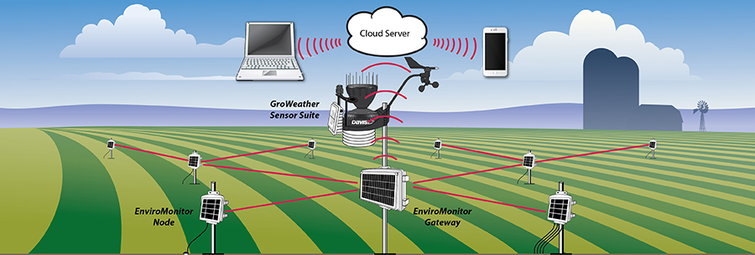
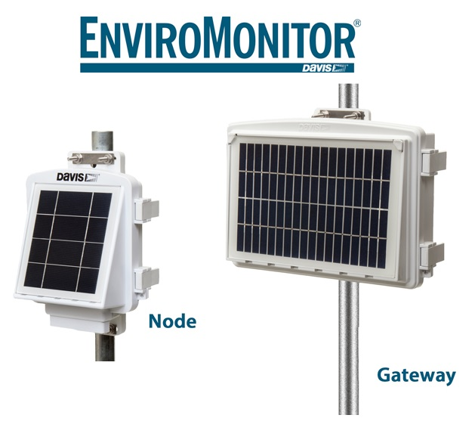
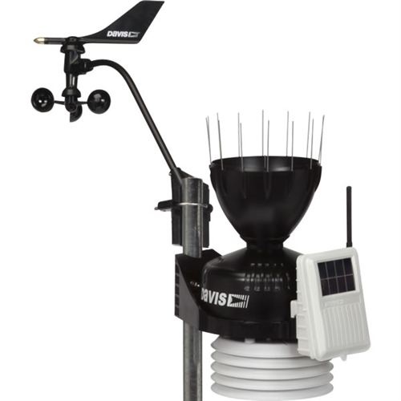
System architecture
Weather
Station

Slide 4
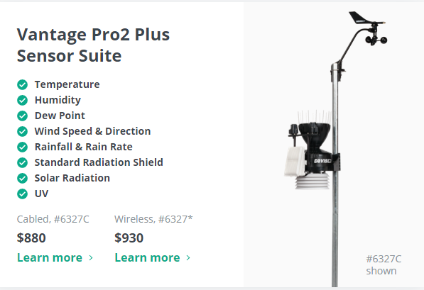
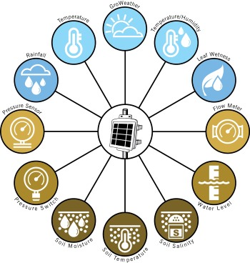
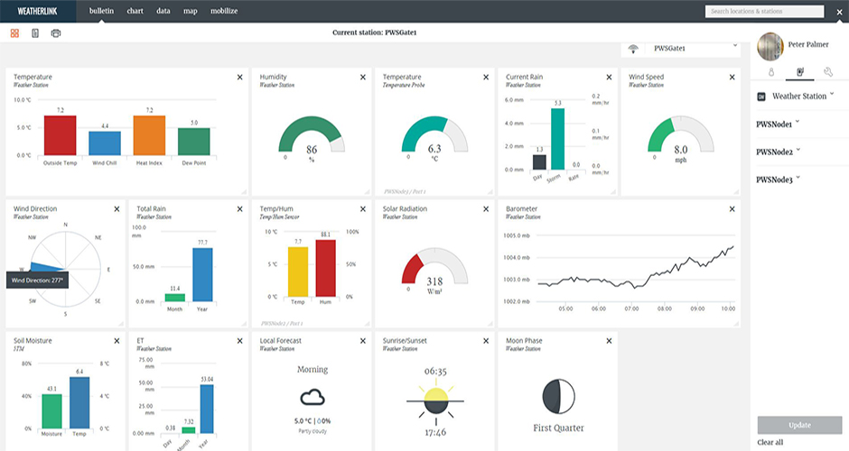
Weather Station
Sensor Node
Website

Slide 5
My Views
Each Node costs about $395. Extremely costly. Only affordable for big agriculture companies. But the products are keeping the industrial standards which is appreciable. The system is not small, it is bulky. So I think it is not suitable for future agriculture requirements. The sensor outputs are accurate. The interface is really good. They have lot of experience in this field. So from this product we will get lot of ideas.

Slide 6
EDYN Garden Sensor (Not for agriculture)
It sense soil and weather conditions
Measures ambient temperature, humidity, light intensity, soil nutrition, pH and moisture
Works on solar panel
Connected via Wi-Fi
Mobile application have an easy user interface and graphics
Good design
Also, they have an automatic solar powered water valve
https://www.kickstarter.com/projects/edyn/edyn-welcome-to-the-connected-garden
https://www.youtube.com/channel/UCV6qhiX7YL0rXzAYFRljl5w/videos

Slide 7
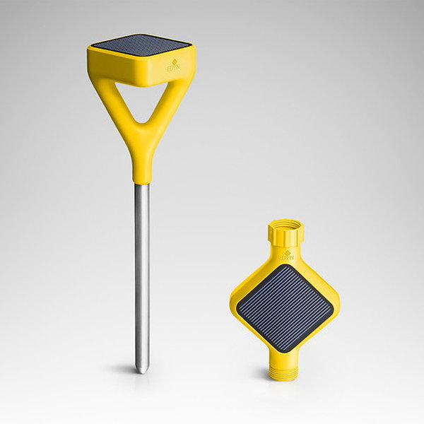
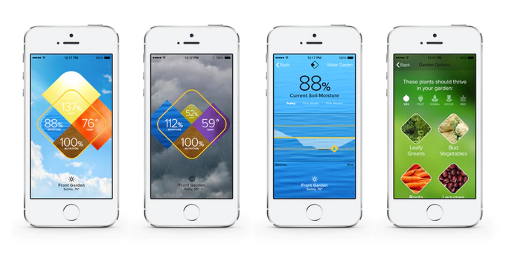
Sensor and the valve
Mobile application

Slide 8
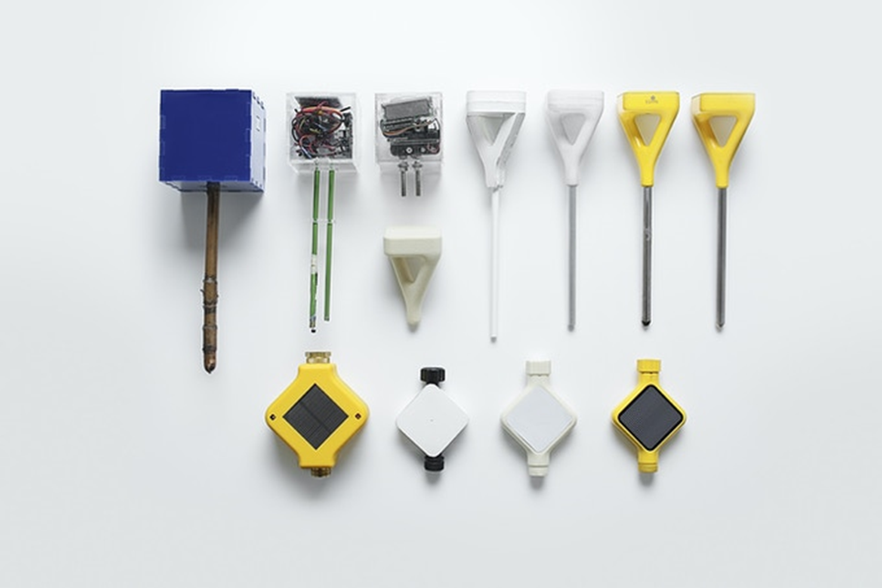
Different stages of product design

Slide 9
My views
I like the design. It is really good. The product is also very small and user friendly. We can monitor the soil just by using mobile. I think here they are using the MEMS technology. That is the reason behind its small size and less power consumption. I like this product. Price is also not that much higher.

Slide 10
(3) eXabit Systems
It is an Indian company (Bangalore)
Provide sensing, monitoring and control
Each node contains soil and weather sensors
Each node send data to cloud
The webpage is really good
Company secured some awards like startup Karnataka, emerge 50
http://www.exabit.in/
https://www.youtube.com/channel/UCPq9Nch-xKN1zWyFUZ4mmtQ

Slide 11
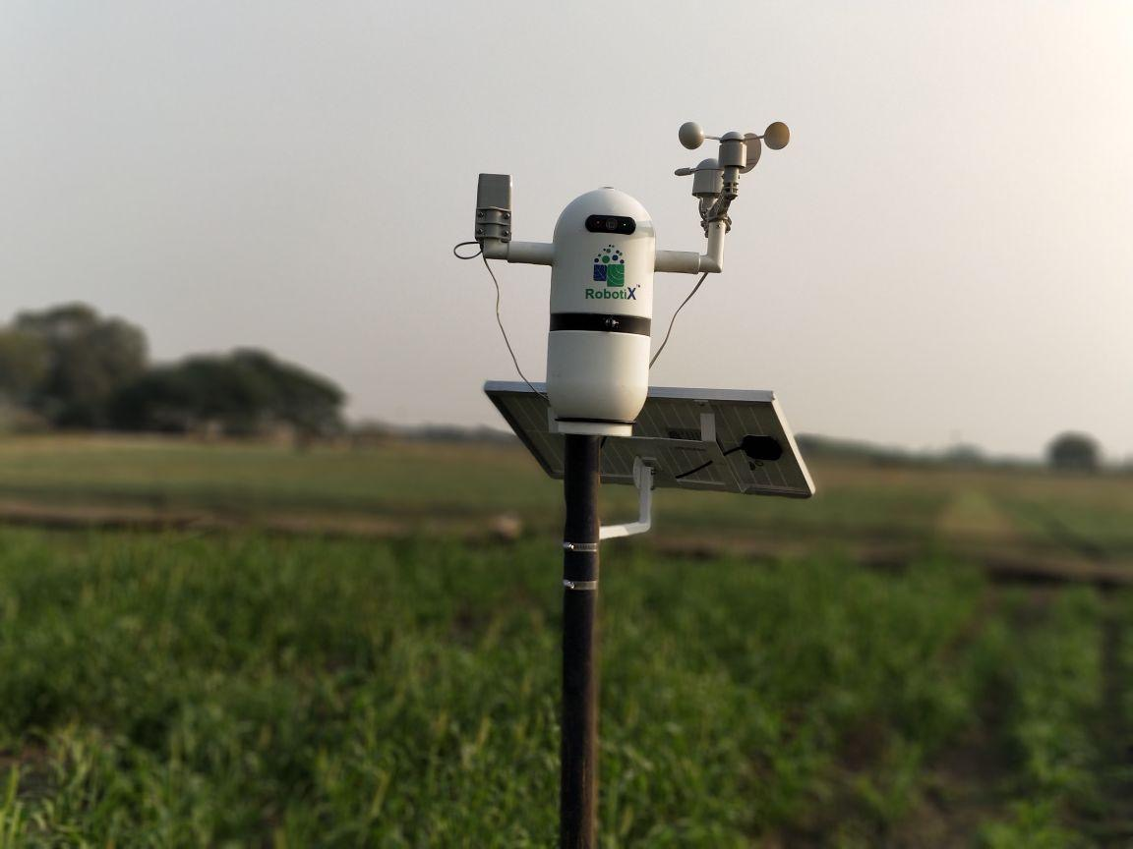

Slide 12
My views
I like their concept and their webpage. Their software side is good. But the design is not that much appreciable. I think they are using traditional sensors. In my point of view, it is not a suitable for next generation agriculture and the technologies are not that much new.

Slide 13
(4) Fasal Systems
It is an Indian company
Fasal started with a simple idea - Removing guesswork from farming. It makes on-farm predictions using AI.
It measure soil and weather data
They are mainly focusing on the software part
https://fasal.co/
https://www.youtube.com/channel/UC1tfdmsgwvwBA2BDTxLRwdQ

Slide 14
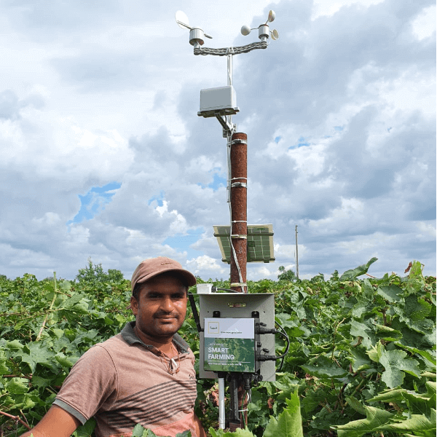

Slide 15
My views
The software side is good and the concept is also good. But the hardware side (design) is not that much good. It has only a single node. I think here also they use the traditional sensors.

Slide 16
2. My Ideas on our System
Our system consist of a set of sensing nodes and it transmit (wirelessly) measured data to the hub. The hub (capable of sensing weather conditions) send data to the main control system and it also controls the automation systems mainly the irrigation. From hub it again send data to the cloud via Ethernet for remote control and monitoring. The whole system structure is similar to the existing ones which are available in the market. But my plan is to modify the whole hardware setup into a small, wireless, cheap and error free one, mainly the sensor node. If we can able to make a small and cheaper one, it will definitely make a change.

Slide 17
The System Architecture
Automatic Control
Main Control Station
Ethernet
Sensor Node
Sensor Node
Sensor Node
Sensor Node
Hub
Sensor Node
Sensor Node
Hub
Sensor Node
Sensor Node

Slide 18
Our Goals
The sensor node must be small, cheap and able to communicate via wireless means ( I think MEMS sensors will helps us to make it possible)
The design (shape) must be a unique one (It should get an appreciation in the first sight)
All the systems must be capable of driving from solar power
The power consumption should be low
The system must be an expandable one. It should help us to add more actuators for automation, to add robots etc.

Slide 19
The Challenges
Finding the suitable sensor (important)
Suitable wireless communication protocol
Reduction of energy consumption
Stability of the measurements
Keeping the production cost at a low level

Slide 20
An Awesome New Idea
This is one of my new idea, Buried sensor for soil measurements. It will change the whole traditional concepts and also reduces the cost, but the system development is a big challenge. The power source is the main problem. We want to find low power components and sensors to reduce the power consumption, but definitely it will change the way of measurements.

Slide 21
But… Unfortunately One Company already achieved it!

Slide 22
(5) Soil Scout
The Most Advanced Wireless Soil Moisture Sensor
Fully buried underground wireless soil sensor
It measure salinity, temperature and moisture
Battery Life up to 20 Years
https://soilscout.com/
https://www.youtube.com/watch?v=FeP1iuzXygA

Slide 23
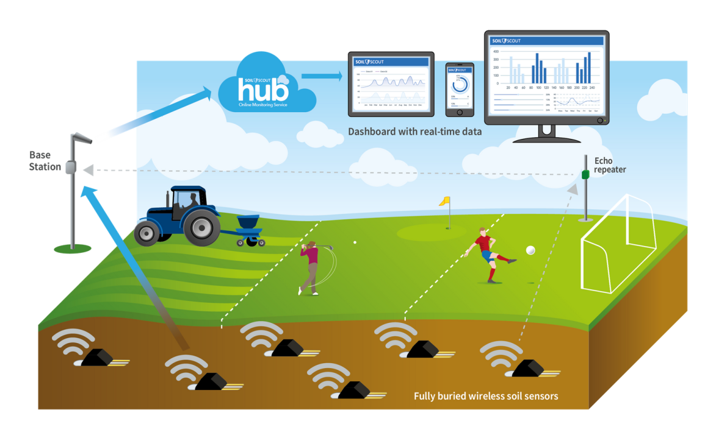
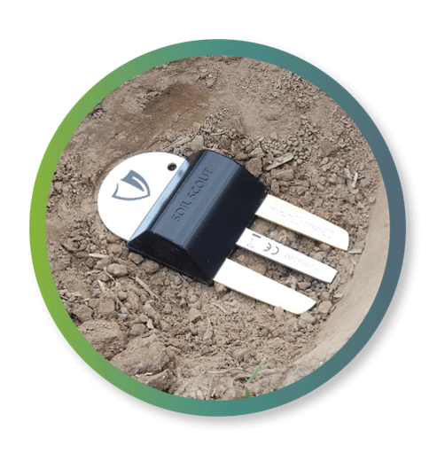
Sensor
Architecture

Slide 24
My views
It is really good and the 20 years of battery life is unbelievable. It works perfectly fine. The design is very good. I think for agriculture, we can add more features to it.

Slide 25
Conclusion
The plan from my side is to create a unique sensor node. I think this is the main challenge. If we can, then the other steps are not that much difficult. Because there are no Indian companies those are focusing on the sensor node. So it is a better opportunity to focus on that section. I think, it will definitely hit the market. From my observations I found that, the main problem with Indian companies are the hardware section. They are not bothered about that and they are focusing only on the software section. That’s why all the foreign hardware are came into the picture. So if we can focus on the hardware side, it will definitely hit.

Slide 26
References
All the links for the images are given in the corresponding slides.
THANK YOU
( Next week I will focus on the greenhouse monitoring and automation )

